Slide 1
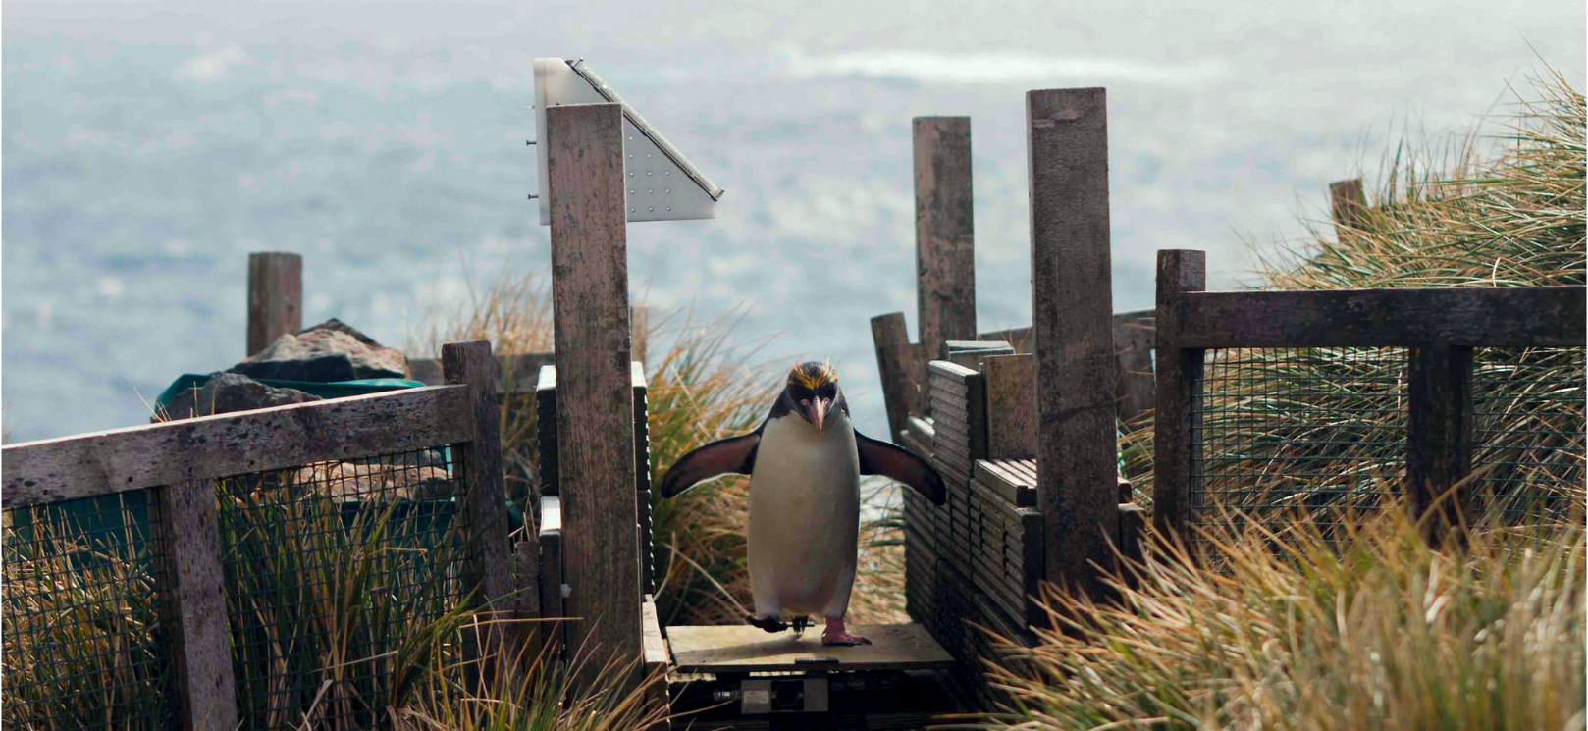
Counting and weighing penguins
really fast with Rcpp
Philipp Boersch-Supan @pboesu
British Trust for Ornithology

Slide 2
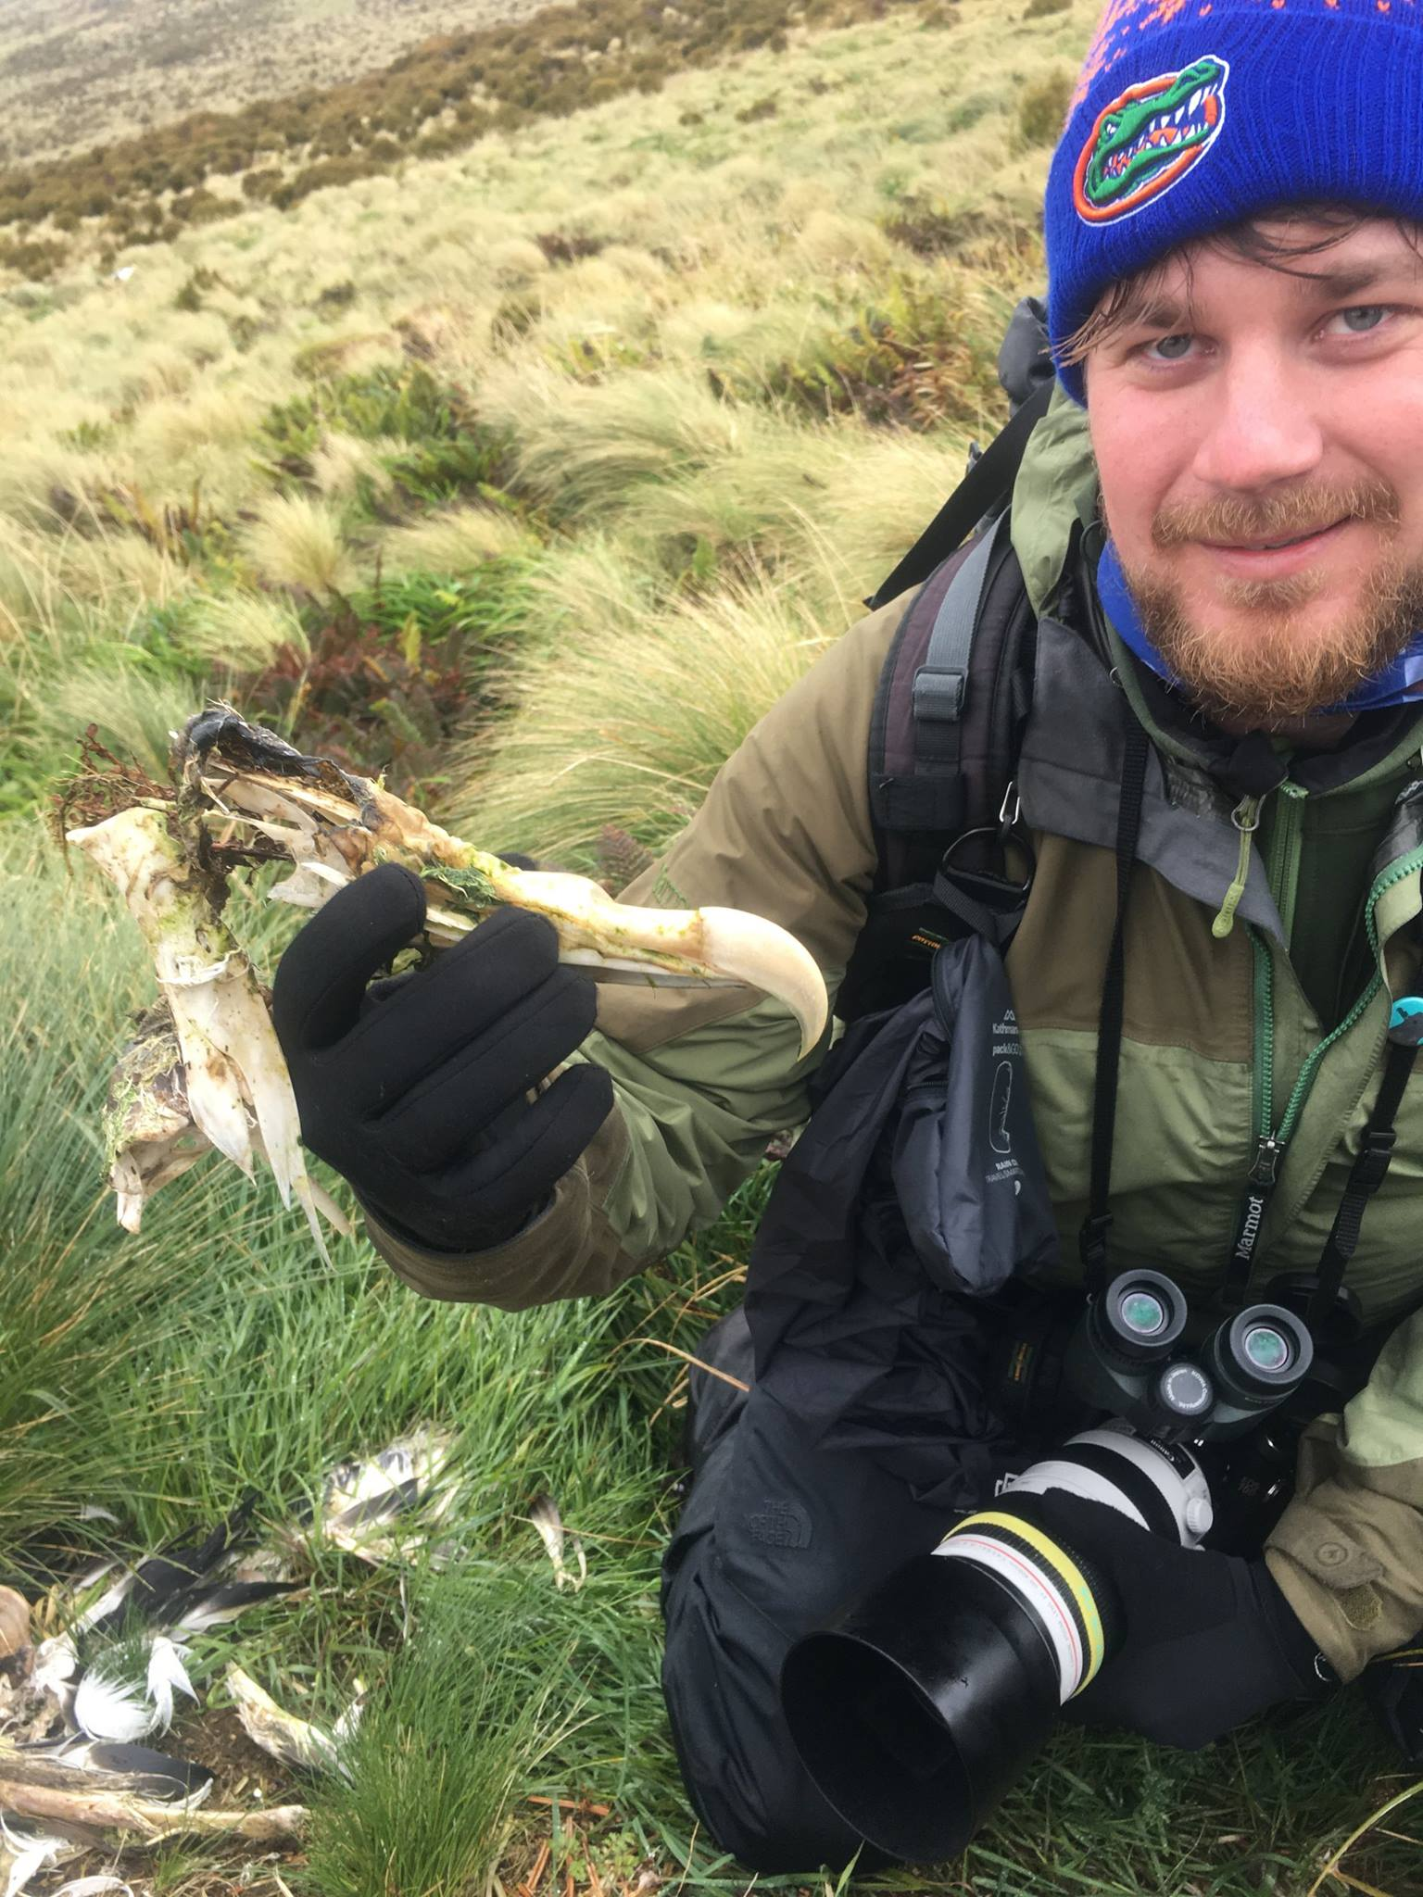

Chemist, Marine Biologist by training
Statistician by accident
useR since 2008
Ecological Statistician at BTO (since April)
We count and ring UK birds with the help of over 40,000 volunteers
We use R extensively for data analysis
But today is about an old project from a far corner of the Empire…
@pboesu

Slide 3
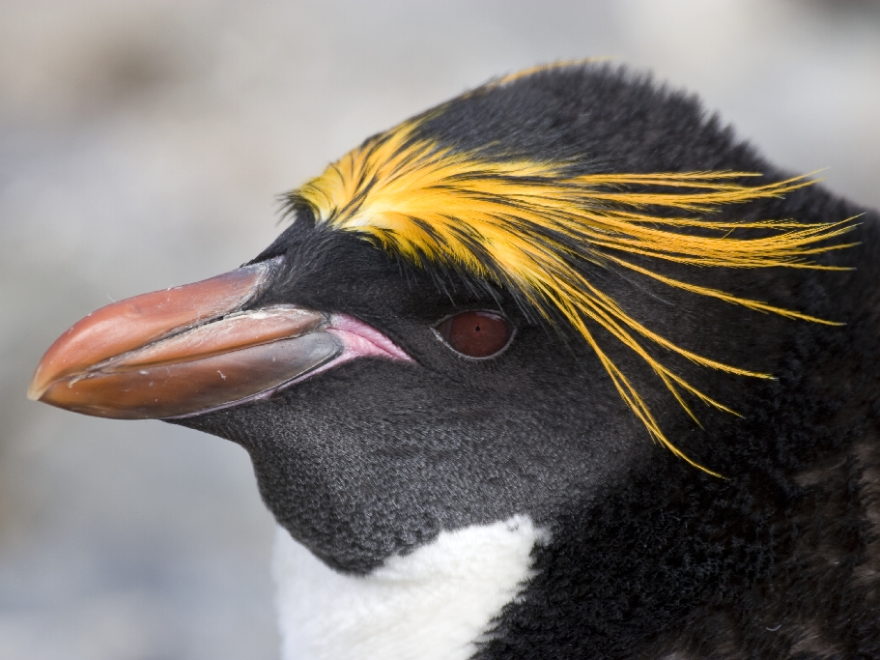

The macaroni penguin Eudyptes chrysolophus
6 million breeding pairs globally
single largest seabird consumer of prey biomass (krill, lanternfish)
populations strongly declining
A Wilson
Bird Island, South Georgia
@pboesu

Slide 4
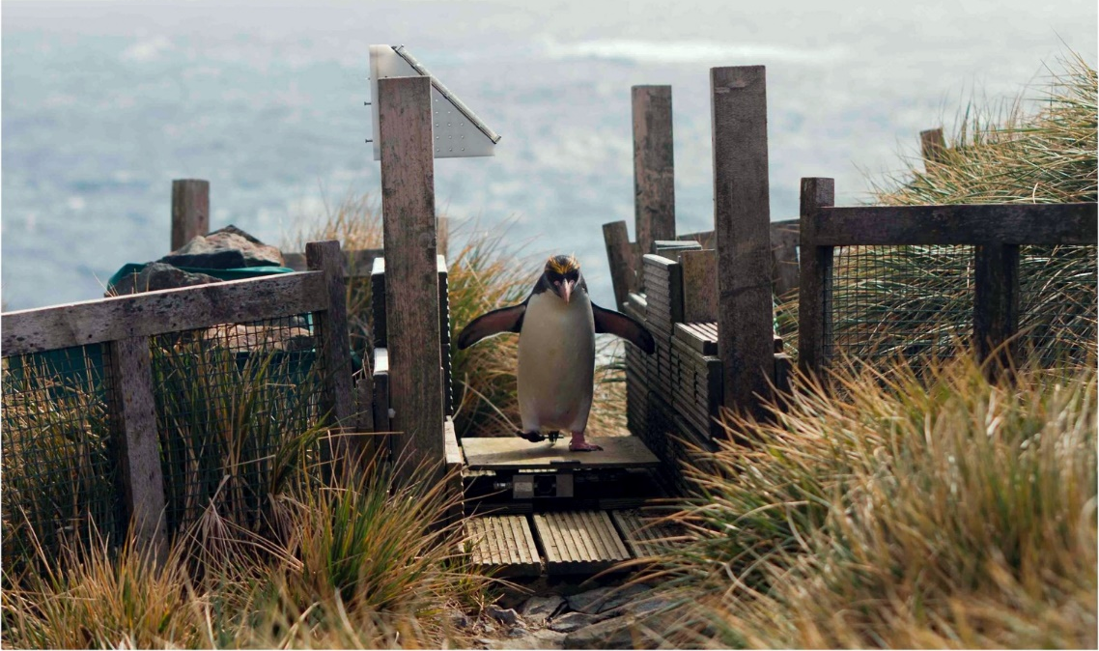
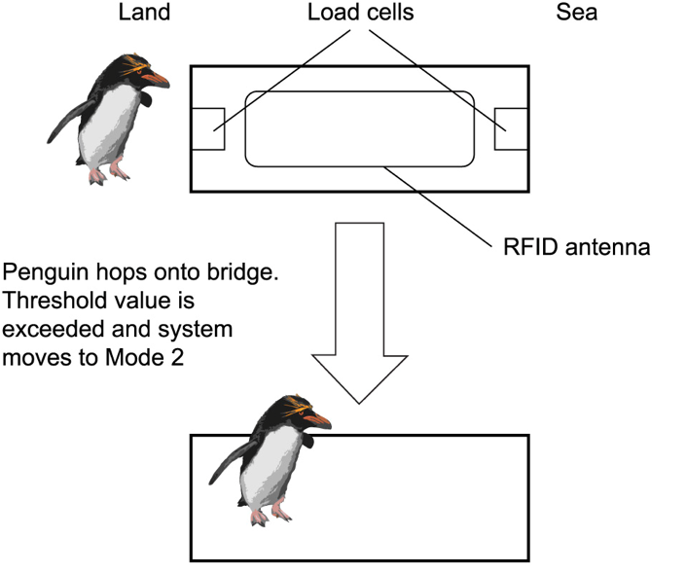
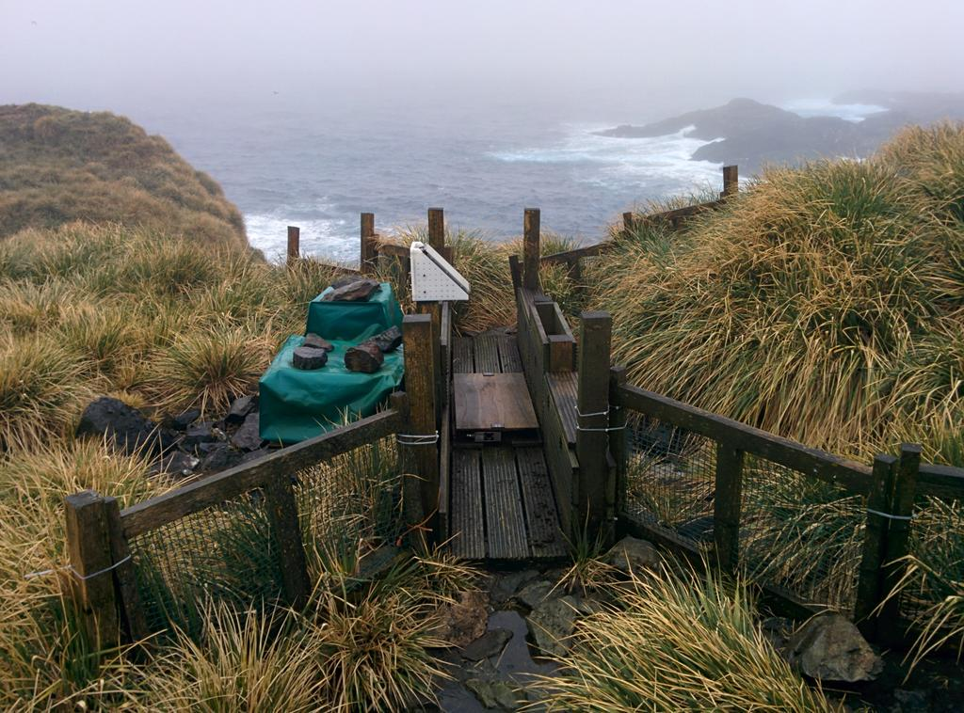
The penguin weighbridge of the British Antarctic Survey
@pboesu

Slide 5
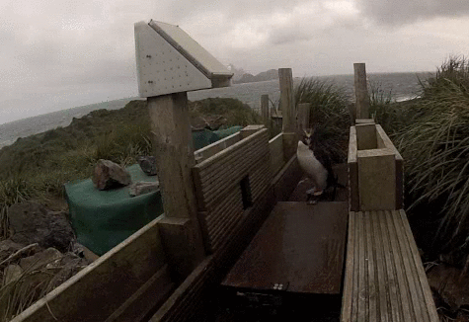
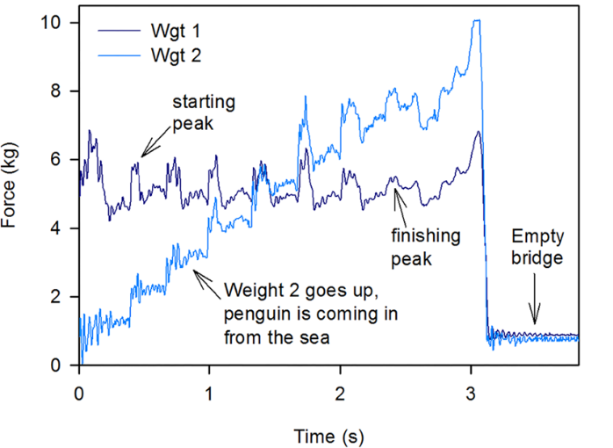
Measurement principle
(1) RFID read identifies individual
(2) Integrate force over time to get penguin mass
(3) Difference between outbound and inbound mass = meal mass
Challenges: accurate mass requires high-frequency sampling
50,000-80,000 crossings/season = 40 – 60 million raw data points/season
@pboesu
Afanasyev et al. 2015 PLoS ONE

Slide 6
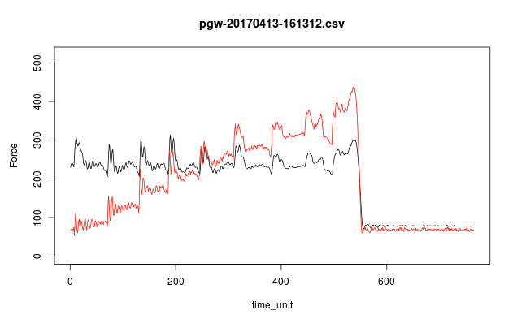
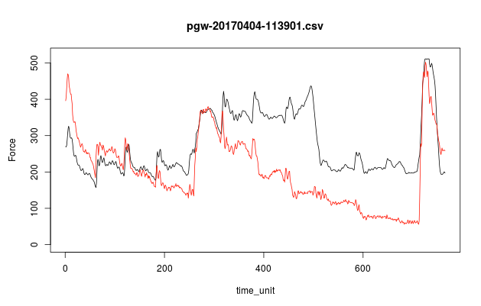
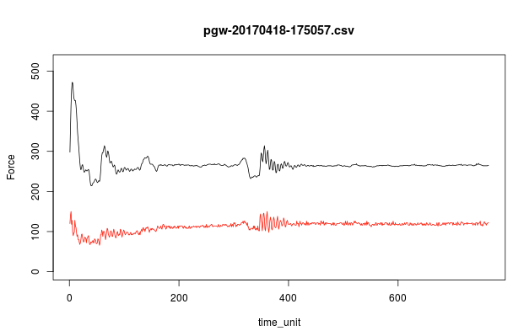
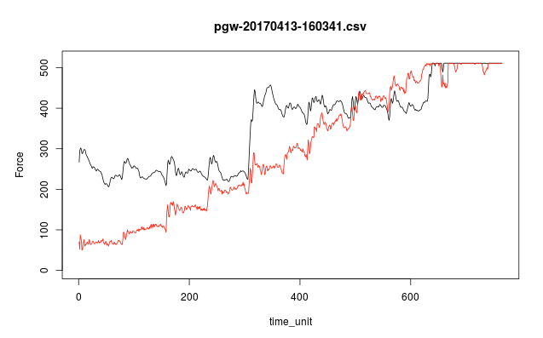
and, penguins don’t play by the rules…
design case: 1 walking bird
too busy: 3 birds in succession
not busy enough: 1 standing bird
way too busy: 3 birds in succession
Easy-ish to separate for the human eye, less easy to automate
@pboesu

Slide 7
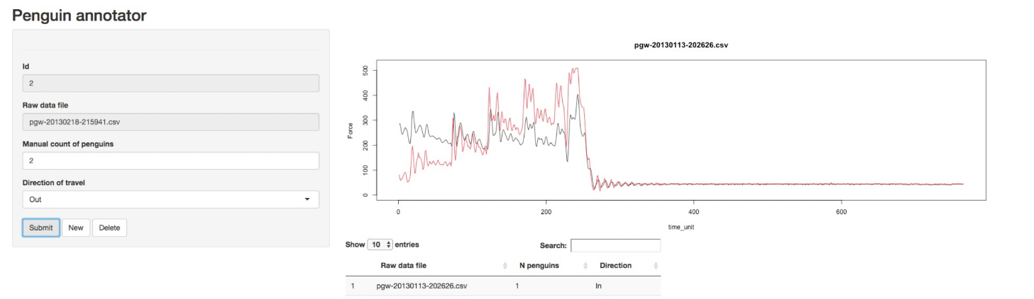
Step 1: The penguin annotator (shiny + RPostgres)
Easy manual classification (but 50k+ files/yr prohibitively time intensive)
Need a classifier that has ‘time-series shape recognition’
@pboesu

Slide 8
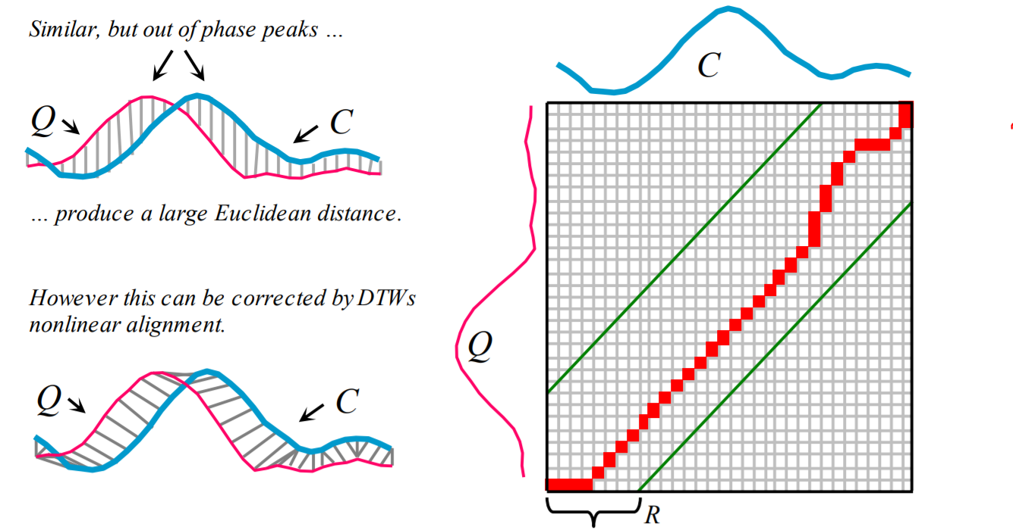
Step 2: Dynamic Time Warping
implemented in R package dtw (using fast C routines), very good accuracy
but too costly (~ 1 minute) to compute full warping path for each crossing
@pboesu
Rakthanmanon et al. 2012, Proc SIGKDD

Slide 9

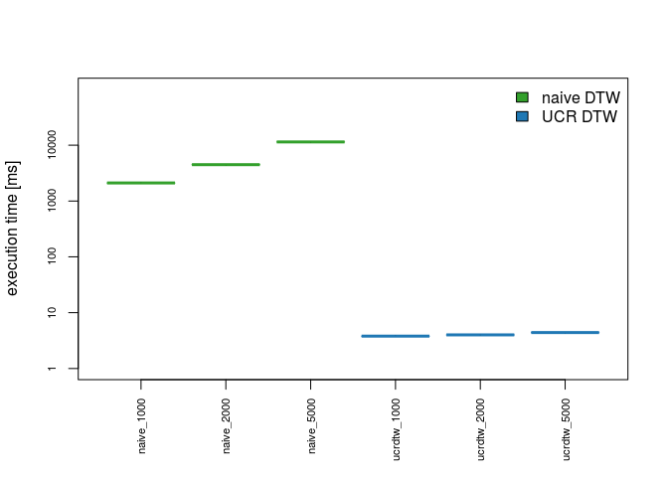
Ultrafast Dynamic Time Warping to the rescue!
‘best match’ search, exploits early abandoning
2-3 orders of magnitude faster than naïve DTW
Open C++ source available
Thanks to Rcpp, draft R pkg rucrdtw working in a few hours
(Maëlle-approved version took a couple weeks more)
Freely available on CRAN: install.packages("rucrdtw")
A single season of penguin crossings can now be classified in <1hr
Rakthanmanon et al. 2012, Proc SIGKDD

Slide 10
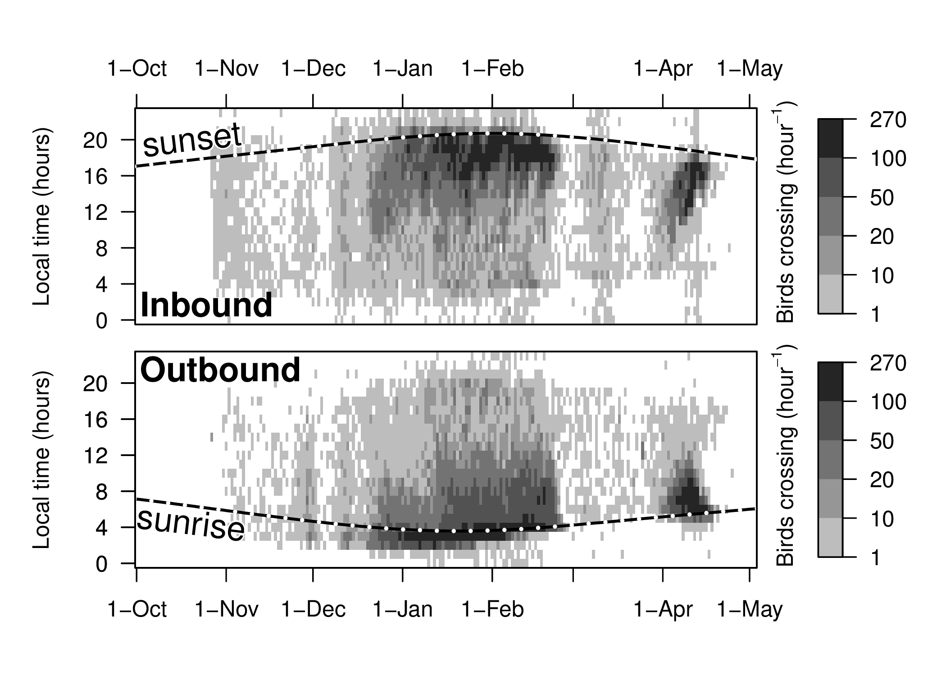
One of several results: rush hour!
Boersch-Supan et al. in prep

Slide 11


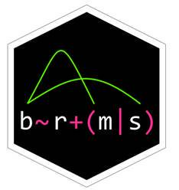






Raw data (read-only psql tables)
RPostgres
Statistical models
Classified crossings
Reference dataset
rucrdtw
Penguin Annotator
Software paper
Research paper
(TBD…)
@pboesu

Slide 12
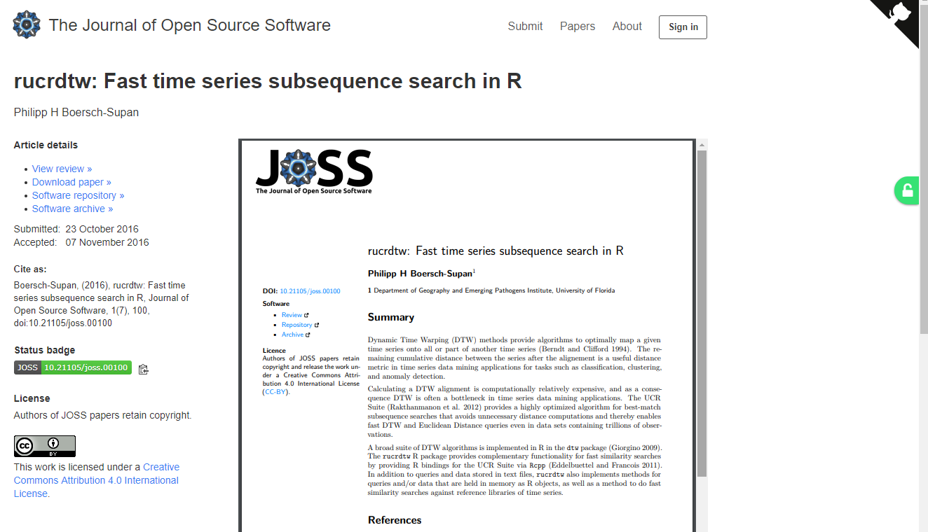
Software paper in JOSS @JOSS_TheOJ
Great experience: Fast, constructive, friendly, transparent
Would recommend!
@pboesu

Slide 13
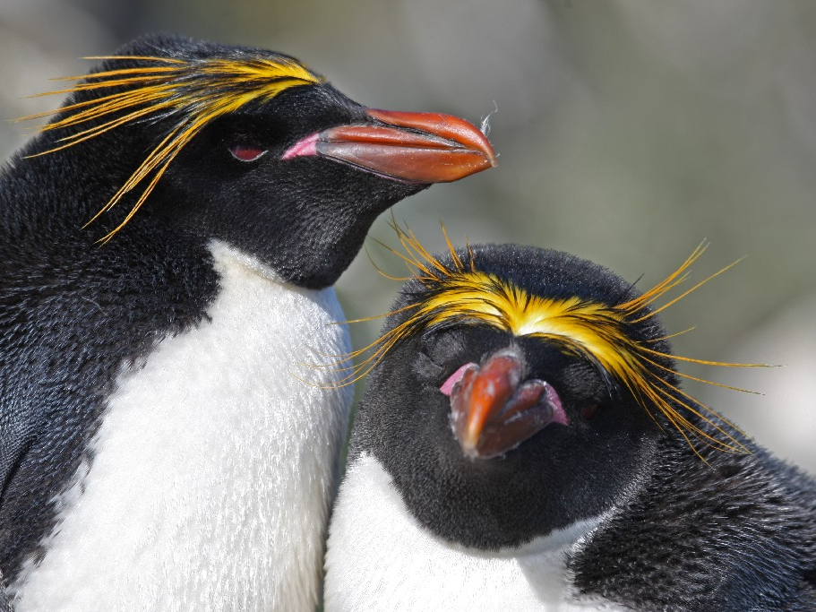
Thank you for listening!
http://pboesu.github.io
pboesu@gmail.com
@pboesu
Thank you to
satRday organizers & sponsors
BAS engineers, data team & field technicians
rucrdtw reviewers & users: Maëlle Salmon, Noam Ross, Florian Pfisterer
BAS

